Slide 1
Capstone Project-01
AirBnb Booking Analysis by Mrutyunjaya Sahoo

Slide 2
What is AirBnb?
Airbnb is an online community marketplace that connects people looking rent their homes with people who are looking for accomodation.
Founded in an Francisco in 2008 as a start-up, the company has become a worldwide booking platform.
Today it contributes the more than 60 million people in 192 countries

Slide 3
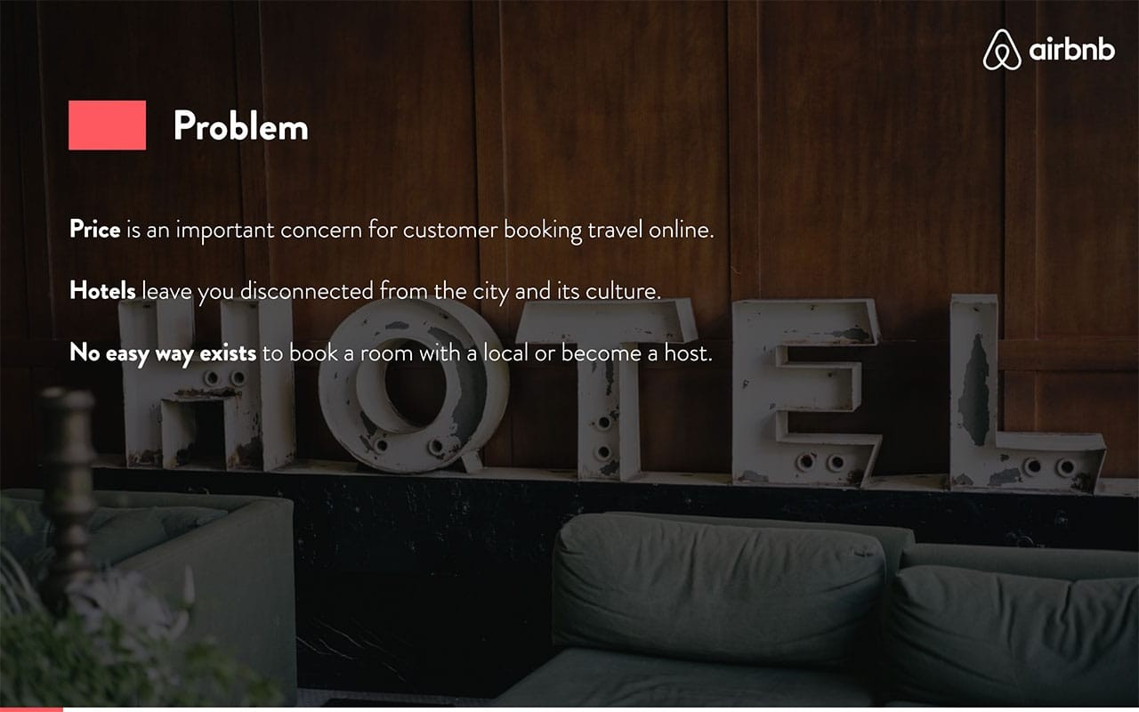

Slide 4
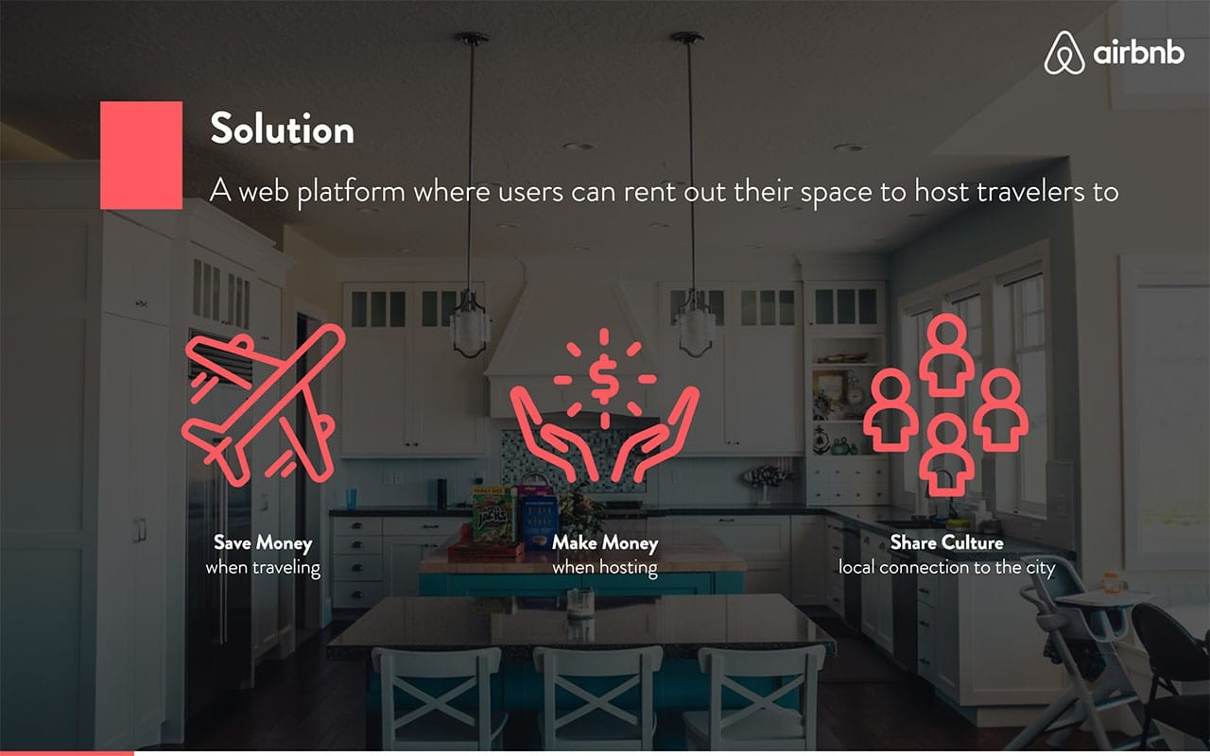

Slide 5
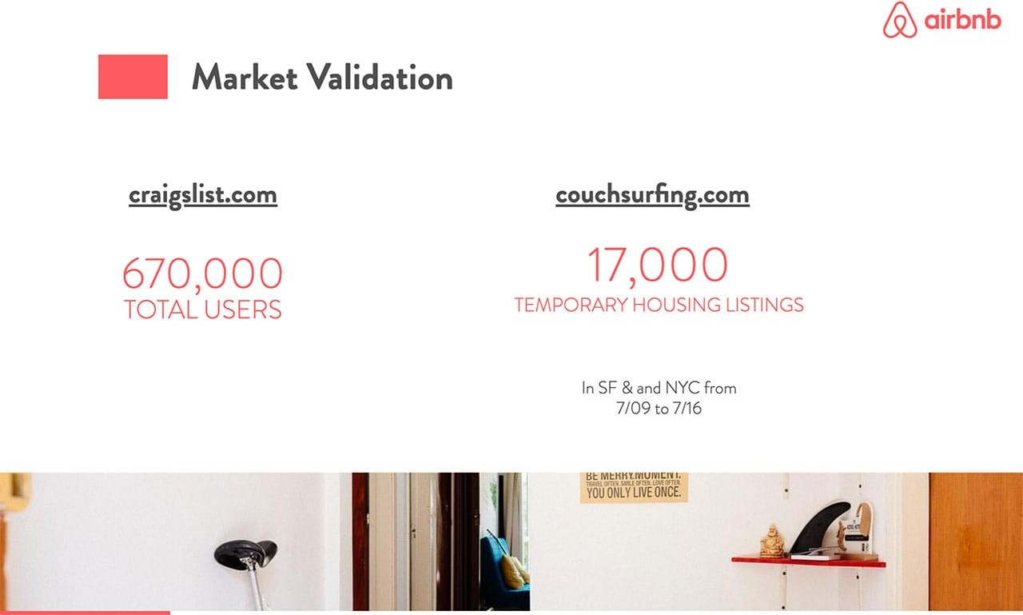

Slide 6
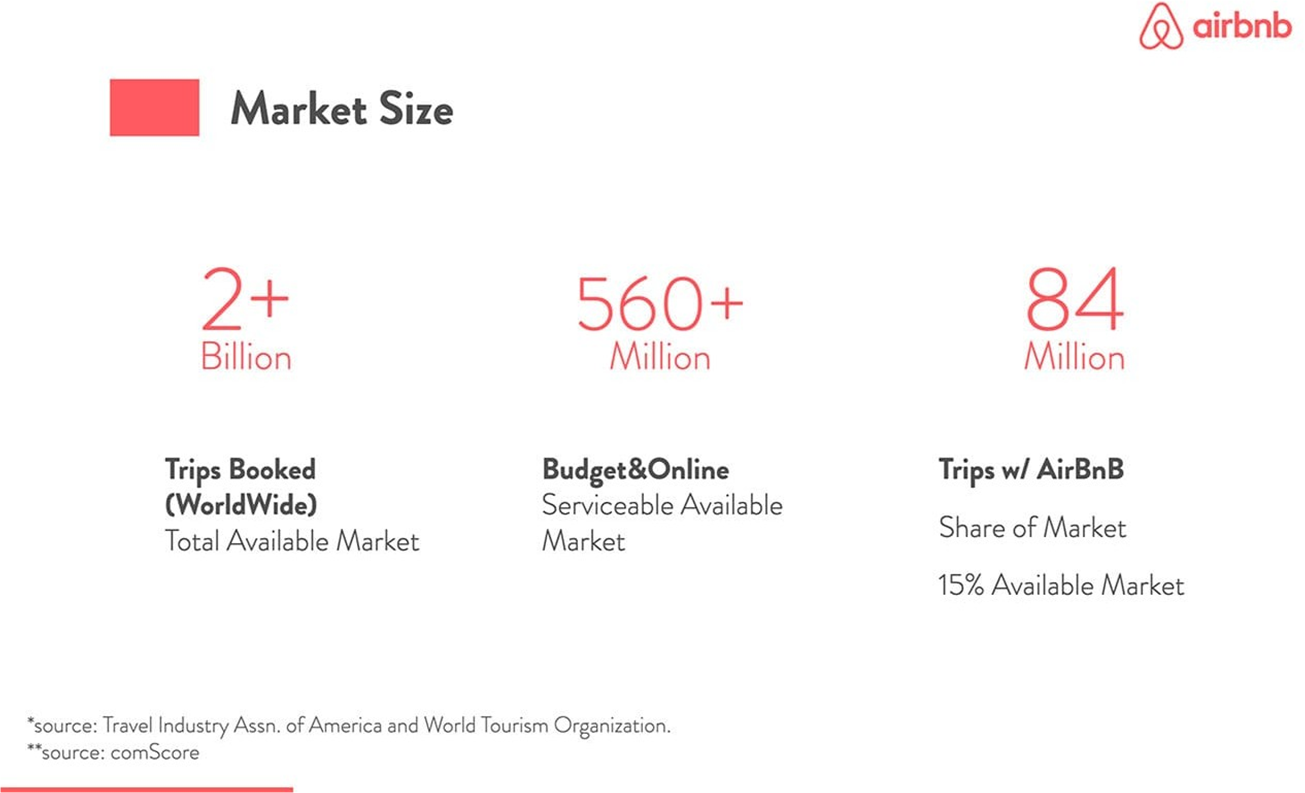

Slide 7
CONTENT:
Introduction
Overview of the dataset
Data cleaning
Exploratory Data Analysis
Observation
Conclusion

Slide 8

INTRODUCTION
Airbnb is an open online platform where people list their own housing for rent. Since 2008, it has grown in popularity and specially for those community which frequently use to travel. It is becoming a strong competitor to the hotel industry. It has millions of listing, which generate lots of data. I’m analyzing these data for making business decision, for looking best room type etc.

Slide 9
Overview of the Dataset
16 Columns
&
48895 Rows

Slide 10
Column Information
id : Unique Id.
name :Name of listing.
host_id : unique id for each listed host.
host_name : Name of the host.
neighbourhood_group : Location
neighborhood : Area
latitude : Latitude coordinates
longitude : Longitude coordinates

Slide 11
Column Information
room_type : Type of listing
price : Price of listing
minimum_nights : minimum nights to be paid for rooms
number_of_reviews : No. of reviews
last_review : Content of the last review
reviews_per_month : Number of checks per month
calculated_host_listings_count : Total count of hosting list
availability_365 :Availability around the year

Slide 12
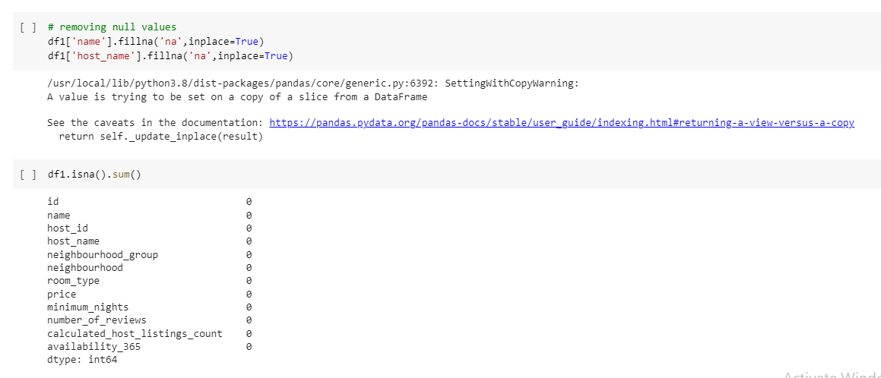
Data Cleaning

Slide 13
Exploratory Data Analysis

Slide 14
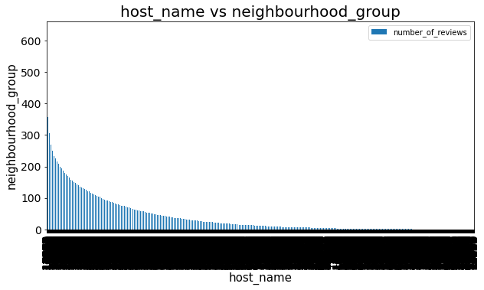
host vs location analysis:
Notes:
Here in this plot we saw a graph between name of hosting and thier location in accordance with their reviews

Slide 15
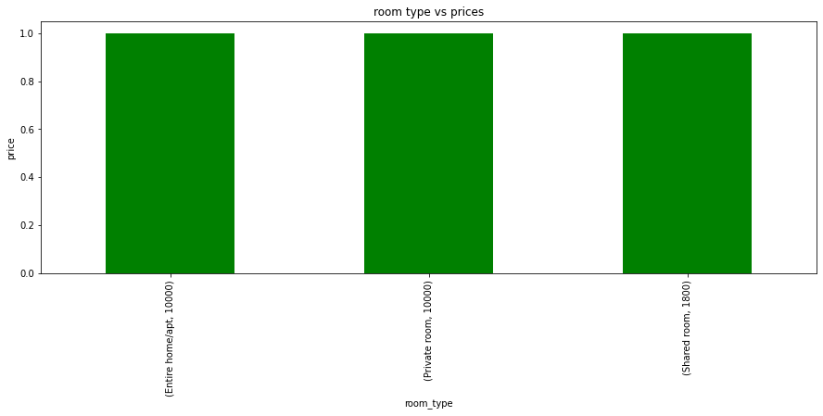
different room type vs prices
Notes:
Here in this sumarry we are understanding how different room type has diffrent price respectively by the help of this bar plot,which gives us a clear view of how price affect the room type

Slide 16
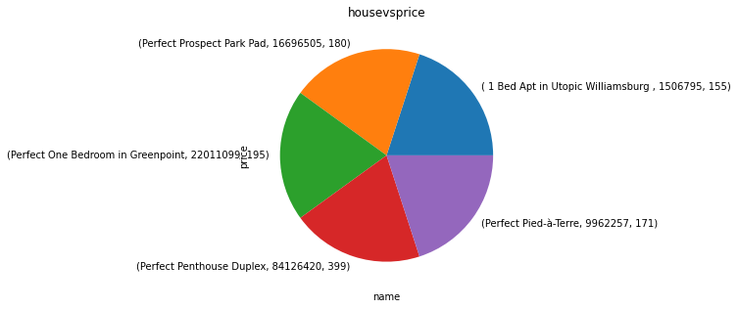
house vs price
Notes:
In this summary we understand what is the price of houses at different location

Slide 17
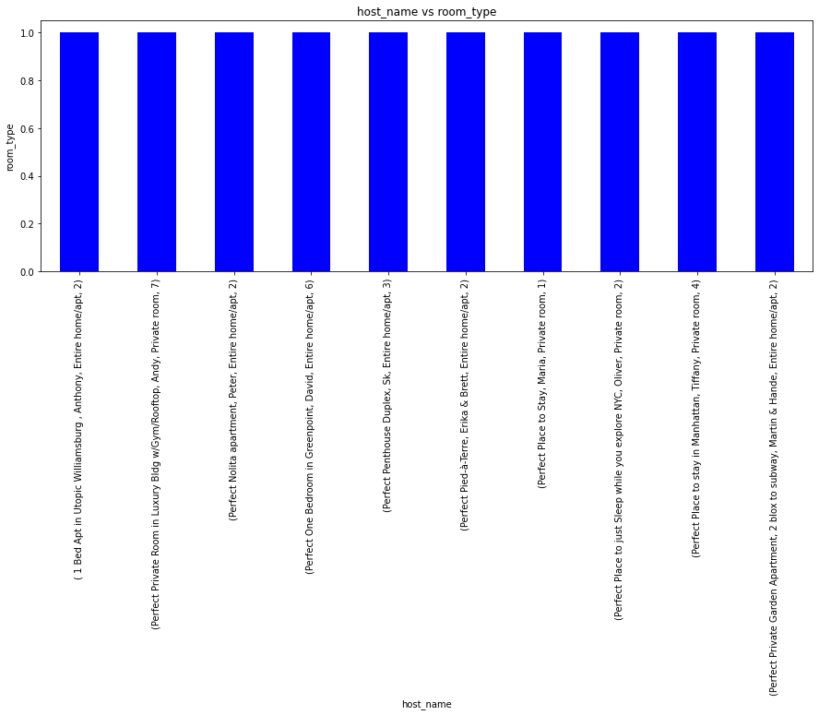
who has hosted different room type with respect of minimum nights
Notes:
Here we saw different host has different types of room and hosted atleast some nights and this data has been properly understood by this bar plot

Slide 18
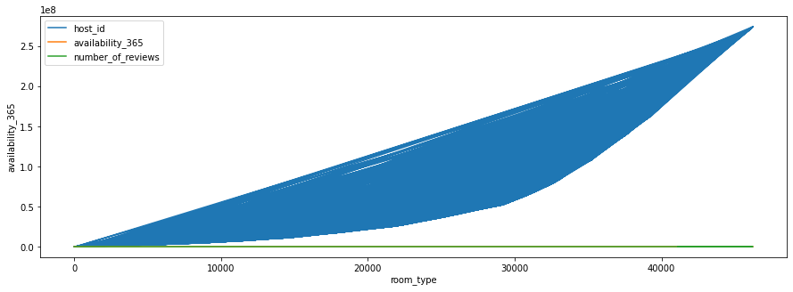
room_type vs availaility based on number of reviews
Notes:
In this plot we saw how many rooms available has the host also understand thier reviews by this line plot

Slide 19
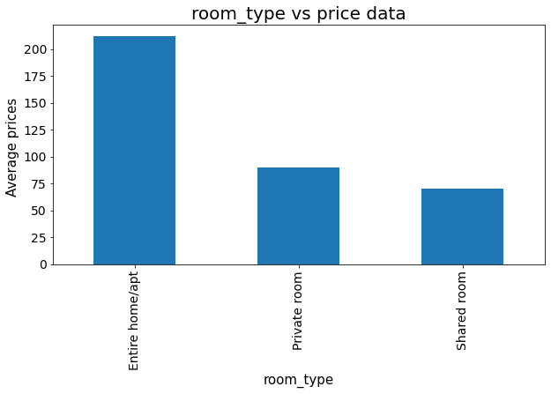
Comparing Average house prices for different room types
Notes:
In this bar plot we saw which room has average prices that gives us how to book a classic room or any type of room in accordance with prices

Slide 20
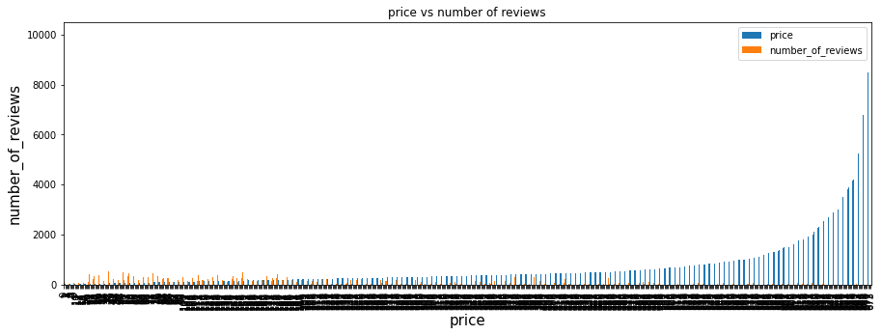
price vs number of reviews

Slide 21
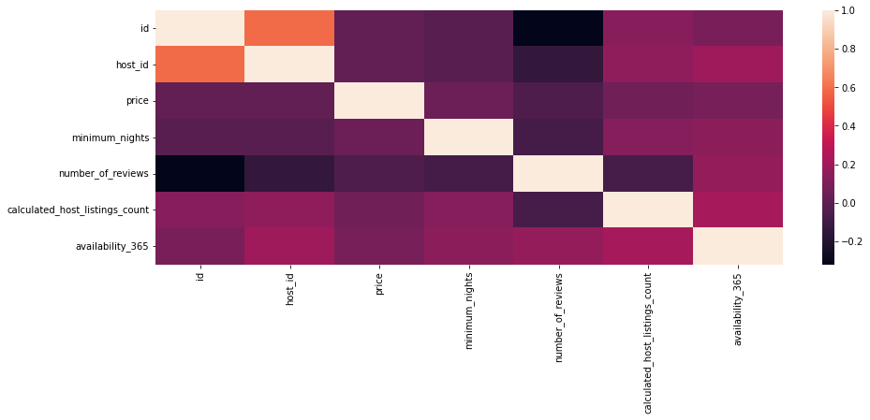
Heatmap Discussion

Slide 22
CONCLUSION

Slide 23
THANK YOU!

